Slide 1


CLUB OF ROBOTICS
SIDDAGANGA INSTITUTE OF TECHNOLOGY
Hackfest’23
Theme :CARRER PATH
SKILLS
GENERAL ENGINEERING

Slide 2
Introduction
(Problem statement, Introduction to project, Objectives)
The problem statement focuses on the existing gap between the skills acquired through engineering education and the skills required by industries. This gap creates challenges for engineering graduates in effectively transitioning into the workforce and meeting industry expectations.
Engineering education often emphasizes theoretical concepts and academic knowledge, but it may not sufficiently address the practical skills demanded by industries. Graduates may lack proficiency in specific programming languages, software tools, or hands-on experience with industry-standard equipment and technologies.

Slide 3
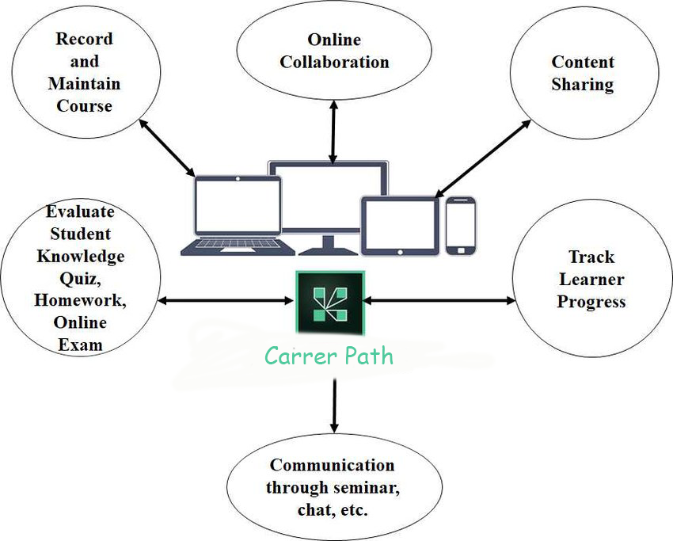
Block diagram

Slide 4
Methodology
(Working, tech stack)To solve the above the problem ,we are created a platform where a student can build the The problem statement focuses on the existing gap between the skills acquired through engineering education and the skills required by industries. This gap creates challenges for engineering graduates in effectively transitioning into the workforce and meeting industry expectations.Engineering education often emphasizes theoretical concepts and academic knowledge, but it may not sufficiently address the practical skills demanded by industries. Graduates may lack proficiency in specific programming languages, software tools, or hands-on experience with industry-standard equipment and technologies.
industry required skills at the early stage of their Engineering.This resolves the gap between the curriculum and industry level skills .
The Login page asks for the user credentials where user can login and get into their respective website .
We are building a platform that consists of various available resources for respective domains .The various domains includes:
1.CyberSecurity
2.Internet of Things

Slide 5
3.Web Development
4.App Development
5.BlockChain
6.Cloud Computing
7.Programming and software Development
We provide flexibility to students to select the domains of their own intrest.We will be providing the information related to each domain in sequential order. In each domain we will be providing the videos ,links of various study material which are easy to understand and apply the principles practically.
We will be providing required number of modules for each domain.After each module we will provide quiz
which approximately consists of 10 to 15 questions.Student is allowed to go to next module ,if they score minimum of 70% in quiz.At the end of their domain ,a test will be given.Badges will be provided based on
their performance in test.This Badges will add value to their Resume.If a student interested in other domain
he/she can go to other domain also.
This enhances their practical skills in particular domain and also their project building skills.
Technologies used :HTML CSS JAVASCRIPT

Slide 6
Applications
E-Learning Platforms: Educational websites can serve as comprehensive e-learning platforms, providing access to online courses, tutorials, lectures, and educational materials. They enable learners to study at their own pace, access resources from anywhere, and engage with interactive content.
Online Tutoring: Educational websites often incorporate features that facilitate online tutoring or virtual classrooms. These platforms allow students and teachers to interact through video conferencing, chat functions, and collaborative tools, creating a more personalized learning experience.
Skill Development: Educational websites offer opportunities for skill development in specific areas, such as programming, foreign languages, data analysis, or graphic design. They provide interactive exercises, practice materials, and assessments to help learners acquire and improve their skills.
Test Preparation: Many educational websites specialize in test preparation for standardized exams and for jobs. They offer study guides, practice tests, and personalized feedback to help students prepare effectively and increase their chances of success.
Supplemental Learning Resources: Educational websites often provide supplemental learning

Slide 7
resources to support classroom teaching. These resources can include educational videos, interactive simulations, quizzes, worksheets, and lesson plans that enhance the learning experience and reinforce concepts taught in school.
Distance Education: Educational websites play a crucial role in distance education, allowing students to access quality education remotely. They provide the necessary tools and resources for teachers to deliver lessons, interact with students, and assess their progress, bridging the geographical gap between learners and educators.
Professional Development: Educational websites cater not only to students but also to educators and professionals. They offer professional development courses, workshops, and resources to help teachers enhance their teaching skills, stay updated with the latest pedagogical approaches, and earn certifications.

